Slide 1
Advances in Data Sciences Final Project
Group 7
Agrawal Priyank
Naik Purnima
Zhang Wanwan
Professor: Dr. Subrata Das

Slide 2
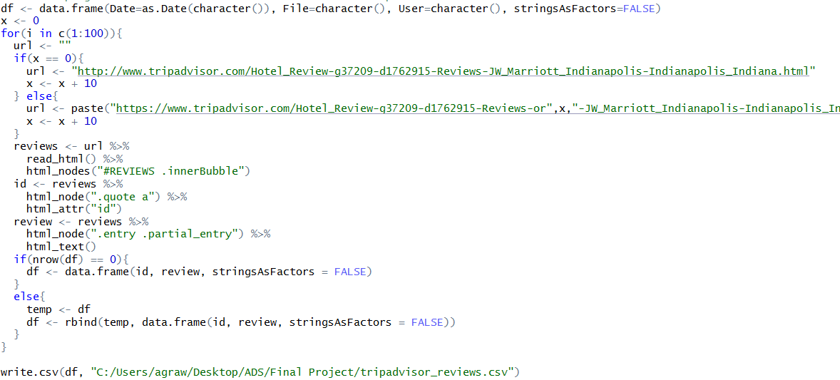
Text Analytics on Trip Advisor
Web Scraping
Notes:
Lesson descriptions should be brief.

Slide 3
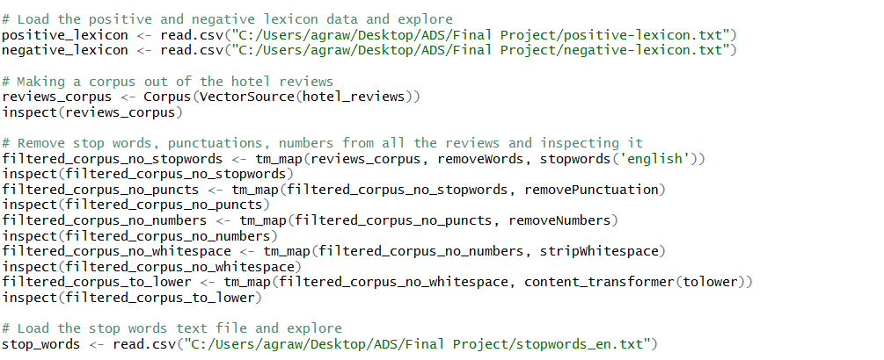
Text Analytics on Trip Advisor
Importing lexicon and Remove words, numbers, punctuation
Notes:
Lesson descriptions should be brief.

Slide 4
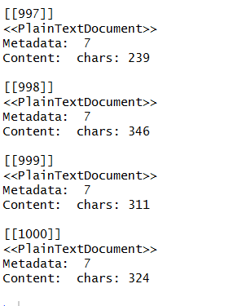
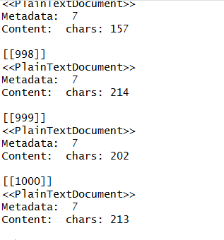
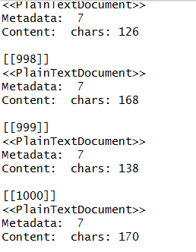
Text Analytics on Trip Advisor
Corpuses
Notes:
Lesson descriptions should be brief.

Slide 5
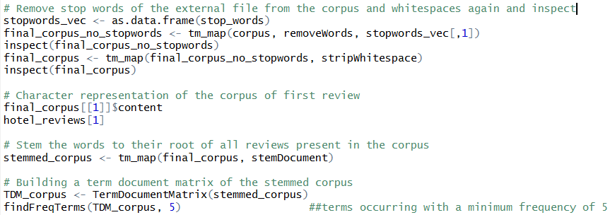
Text Analytics on Trip Advisor
Building Corpus from the dataset
Notes:
Lesson descriptions should be brief.

Slide 6
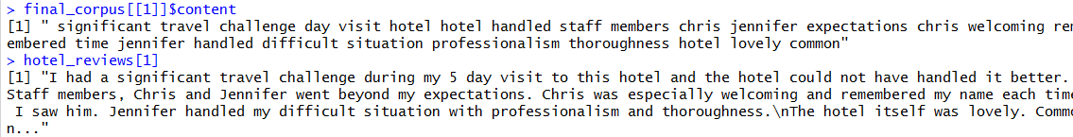
Text Analytics on Trip Advisor
Corpus review and Original review
Notes:
Lesson descriptions should be brief.

Slide 7
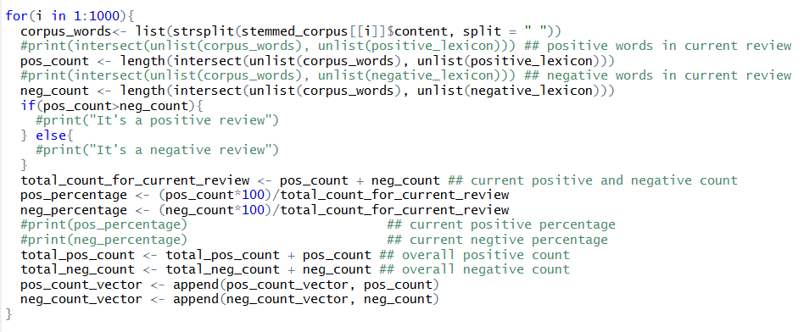
Text Analytics on Trip Advisor
Calculating Sentiments for each review in the dataset
Notes:
Lesson descriptions should be brief.

Slide 8
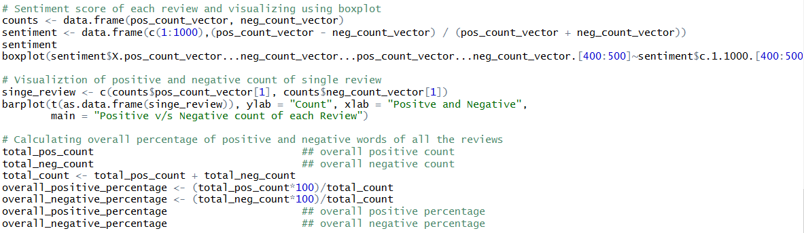
Text Analytics on Trip Advisor
Calculating Sentiment score of each review and visualizing
Notes:
Lesson descriptions should be brief.

Slide 9
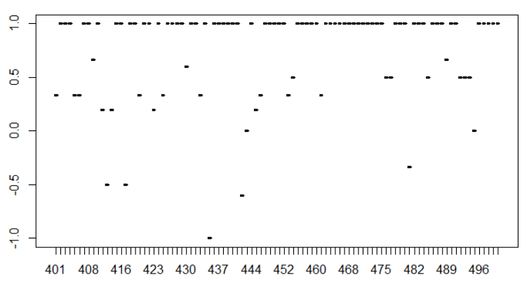
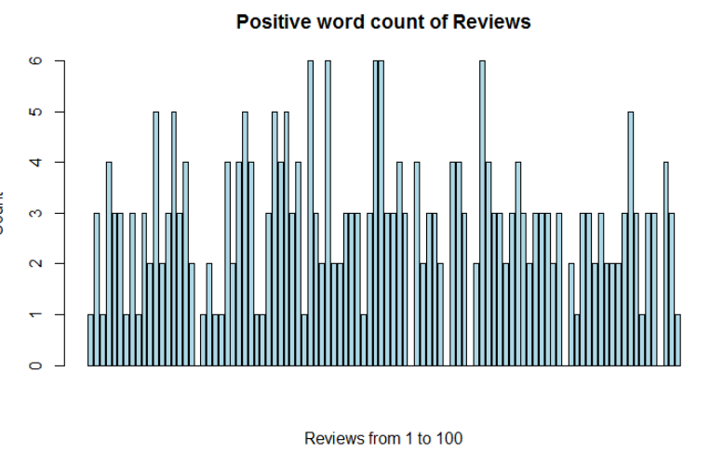
Text Analytics on Trip Advisor
Visualization
Notes:
Lesson descriptions should be brief.

Slide 10
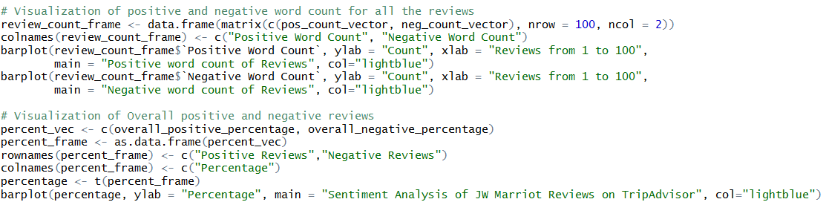
Text Analytics on Trip Advisor
Calculating Sentiment score of all reviews and visualizing
Notes:
Lesson descriptions should be brief.

Slide 11
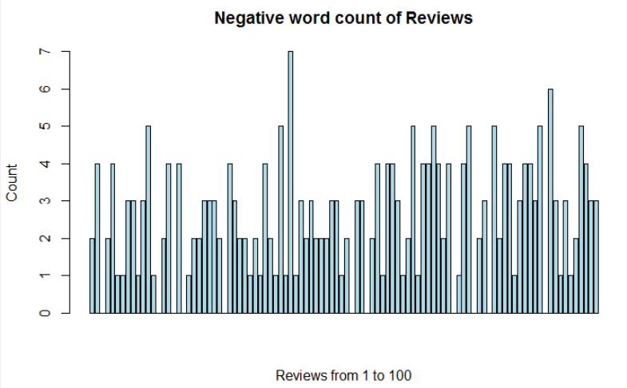
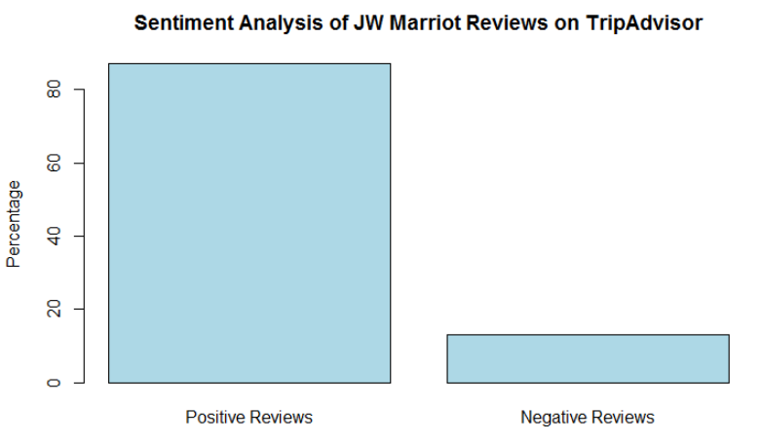
Text Analytics on Trip Advisor
Visualization
Notes:
Lesson descriptions should be brief.

Slide 12
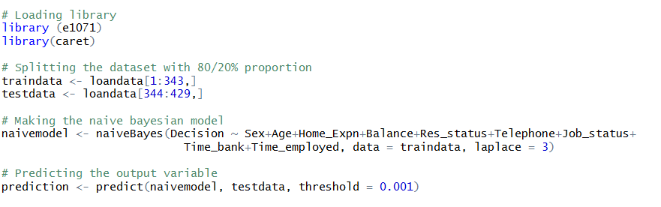
Naïve Bayesian Classifier
Splitting the data, making the model and predicting
Notes:
Lesson descriptions should be brief.

Slide 13
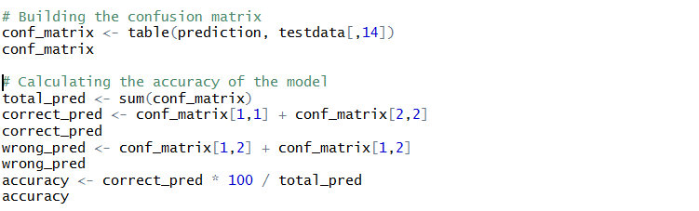
Naïve Bayesian Classifier
Building the confusion matrix and calculating the accuracy
Notes:
Lesson descriptions should be brief.

Slide 14
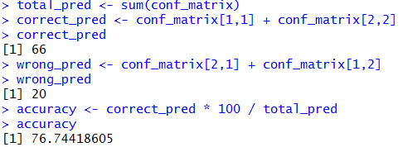
Naïve Bayesian Classifier
Building the confusion matrix and calculating the accuracy
Notes:
Lesson descriptions should be brief.

Slide 15
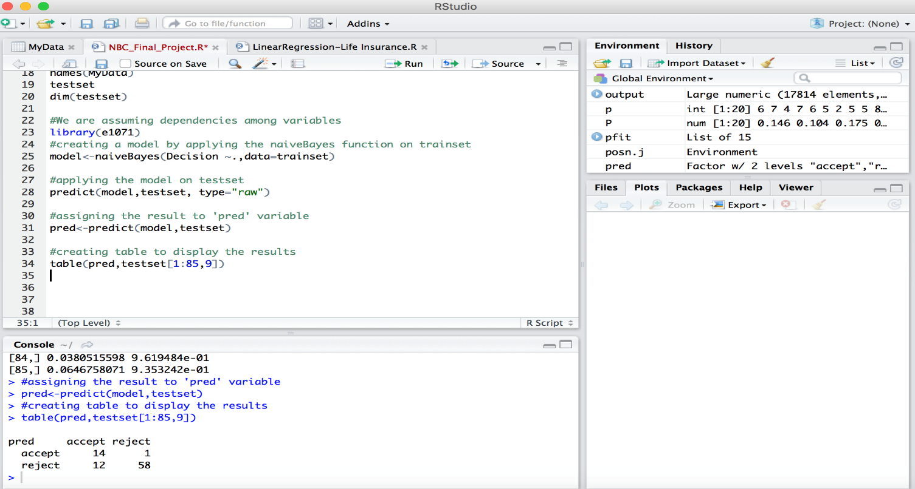
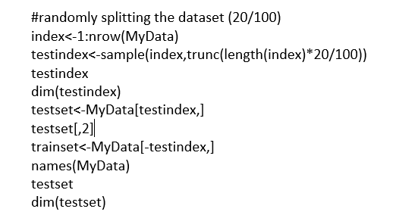
Naïve Bayesian Classifier
Building the confusion matrix and calculating the accuracy
Notes:
Lesson descriptions should be brief.

Slide 16
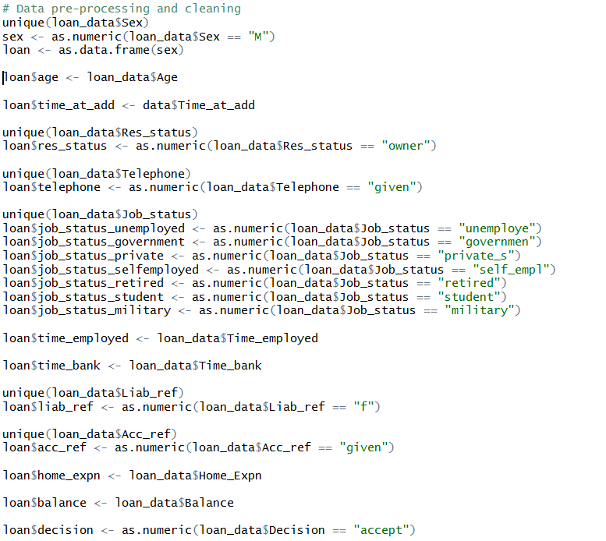
Neural Networks
Data pre-processing and cleaning
Notes:
Lesson descriptions should be brief.

Slide 17
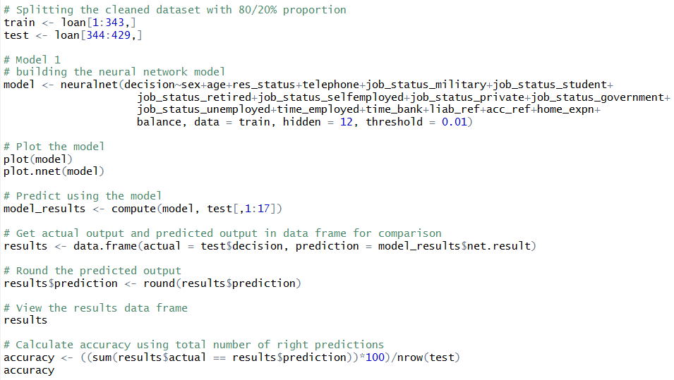
Neural Networks
Splitting the dataset, building the model, predicting, calculating accuracy and visualization
Notes:
Lesson descriptions should be brief.

Slide 18
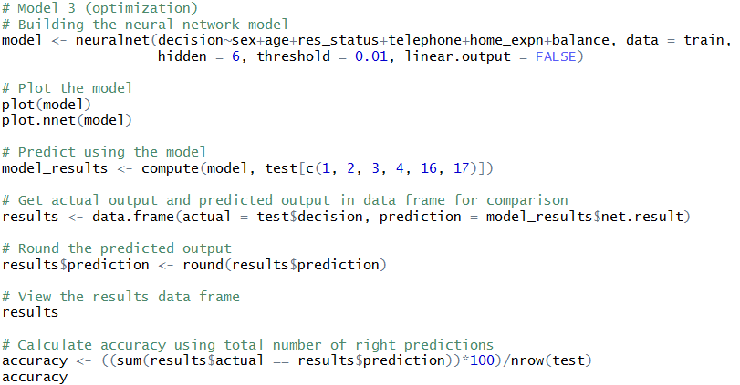
Neural Networks
Optimization Final Model: building the model again, predicting, calculating accuracy and visualization
Notes:
Lesson descriptions should be brief.

Slide 19
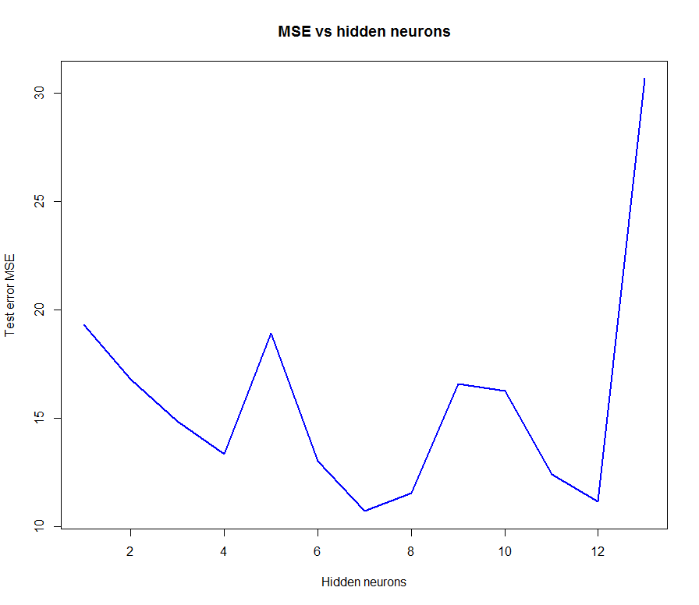
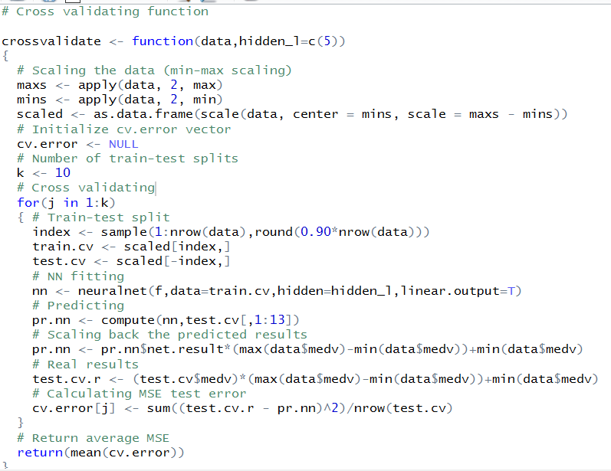
Neural Networks
Cross Validation
Notes:
Lesson descriptions should be brief.

Slide 20
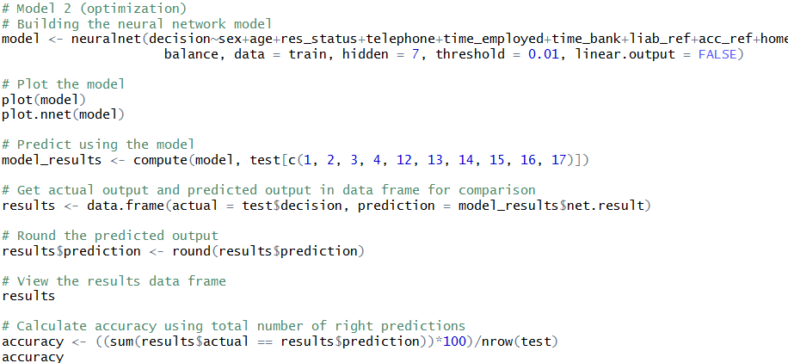
Neural Networks
Optimization Model 2: building the model again, predicting, calculating accuracy and visualization
Notes:
Lesson descriptions should be brief.

Slide 21
Neural Networks
Accuracy
Notes:
Lesson descriptions should be brief.

Slide 22
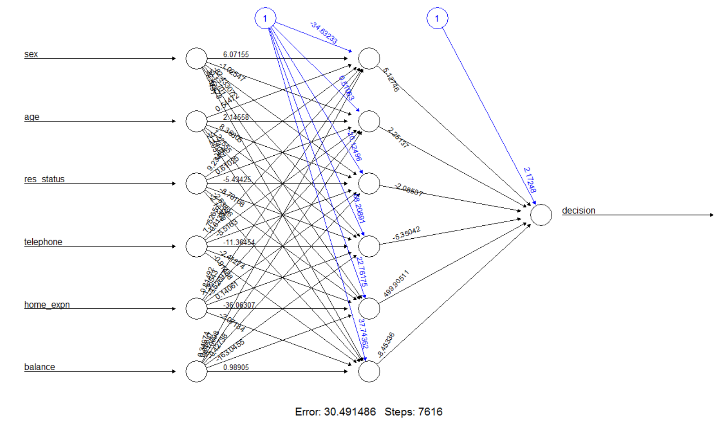
Neural Networks
Neural Model Visualization
Notes:
Lesson descriptions should be brief.

Slide 23
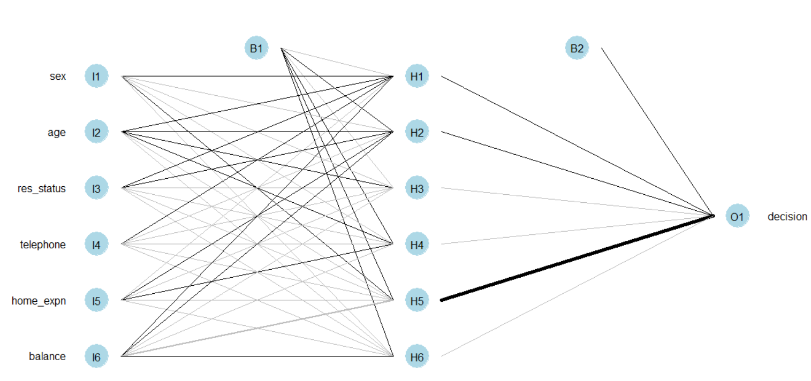
Neural Networks
Neural Model Visualization
Notes:
Lesson descriptions should be brief.

Slide 24
Thank You

